Slide 1
HelpLess Airlines
By Bowtielearning Ltd.

Slide 2
Introduction
Founded in 1999.
Passenger Growth - Exponential.
Current Staff - 200.
Notes:
How presentation will benefit audience: Adult learners are more interested in a subject if they know how or why it is important to them.
Presenter’s level of expertise in the subject: Briefly state your credentials in this area, or explain why participants should listen to you.

Slide 3
Training Outline
How to Fly
  For Pilots Only.
Baggage Handling
  All Operatives.
Check In Protocol
  Ground Staff.
Notes:
Lesson descriptions should be brief.

Slide 4
Pilots Lesson 1: Objectives
Making sure that you have as many landing as takeoffs.
Landing the plane in one piece.
Keeping on the Runway.
Avoiding other planes during the Flight
Timetable Snooze Breaks
Notes:
Example objectives
At the end of this lesson, you will be able to:
Save files to the team Web server.
Move files to different locations on the team Web server.
Share files on the team Web server.

Slide 5
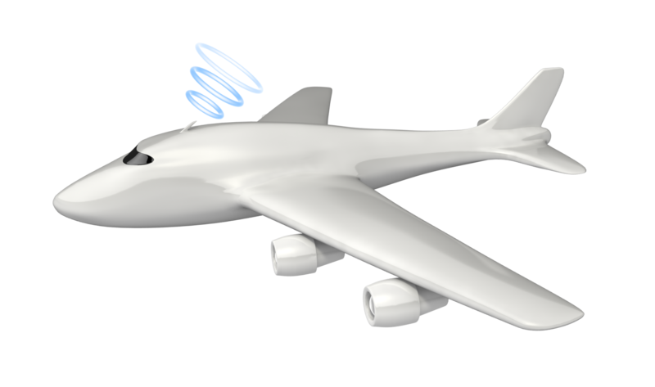

Pilots Lesson 1: Advice
Avoid other Aircraft.
If you see another plane - RUN.

Slide 6


Pilots: Wrap-up
Stay Safe.

Slide 7
Baggage Operatives Lesson 1: Objectives
Putting all the Bags on the right plane
Careful handling of heavy bags
Take plenty of Rest Breaks

Slide 8
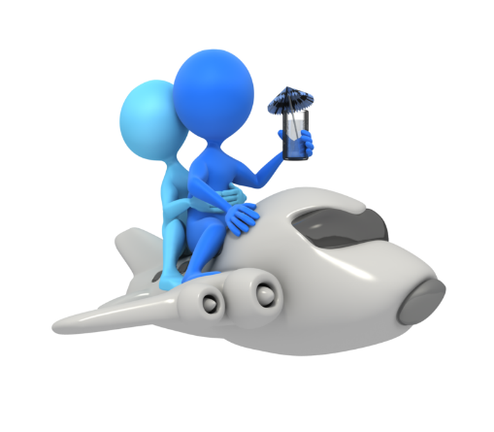



Baggage Operatives: Lesson 1
All bags on right plane.

Slide 9

Baggage Operatives: Wrap-up
Take Rest Breaks

Slide 10
Ground Staff Lesson 1: Objectives
Boarding Passengers.
Tracking Luggage.
Taking Fees

Slide 11


Ground Staff Lesson 1: Advice
Check all the passengers onto the right plane.
Get the luggage to the baggage handlers.
Charge for no tickets.

Slide 12

Ground Staff: Wrap-up
Happy Passengers

Slide 13
Summary of Training
Pilot Training Completed.
Baggage Handlers – absent due to dispute.
Ground Staff
  Need Computers.
  Need Credit Card Machine.

Slide 14
Assessment and Evaluation
Pilots Passed Written Examination.
Need to actually fly now.

